Slide 1
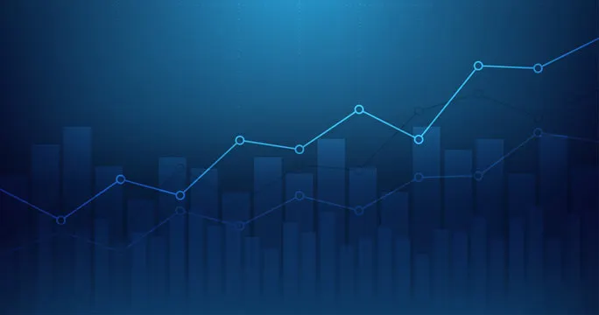
TREND ANALYSIS
WITH
PHONE DATA

Slide 3
STEPS INVOLVED
Understanding Dataset and its Integrity :
What the dataset contains and finding the goodness of the data source
Data Visualization :
Using various representations in python for analysing columns in the dataset
04
02
01
03
Loading Dataset:
To bring our dataset to the code environment for further analysis
Statistical Analysis :
Using statistical functions like mean, median, range, standard deviation, etc,.

Slide 4
DATA VISUALIZATIONS

Slide 5
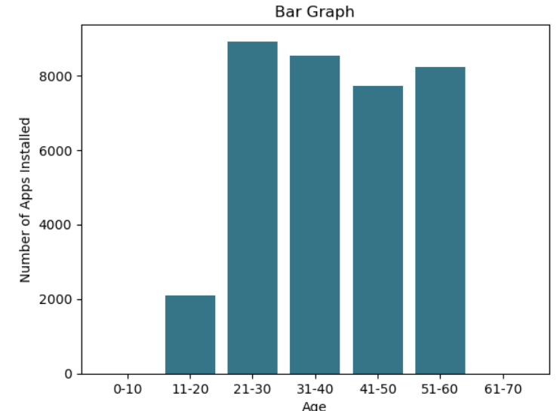
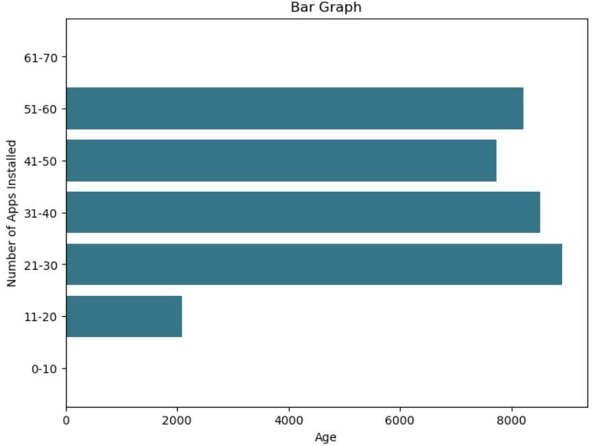
BAR CHART
Represents the relation between different age groups and the sum of the respective age groups apps installed.
Function used to create : bar( )
Showcases that, most of the age groups have a similar sum number of installed apps
Concludes that the age groups 21–30 and 31–40 have the highest total app installations, indicating that young adults use the most apps.
Function used to create : barh( )

Slide 6
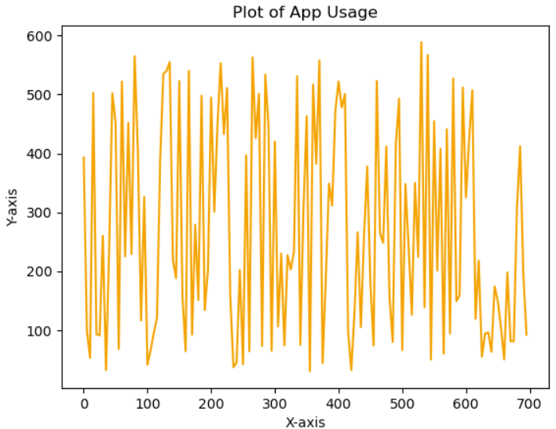
LINE PLOT
High peak indicates - period of higher app usage
Represents the index of every 5th entry from dataset with app usage time.
Low peak indicates – period of lower app usage
Shows the fluctuations across the sampled data, in app usage with respect to the time period.

Slide 7
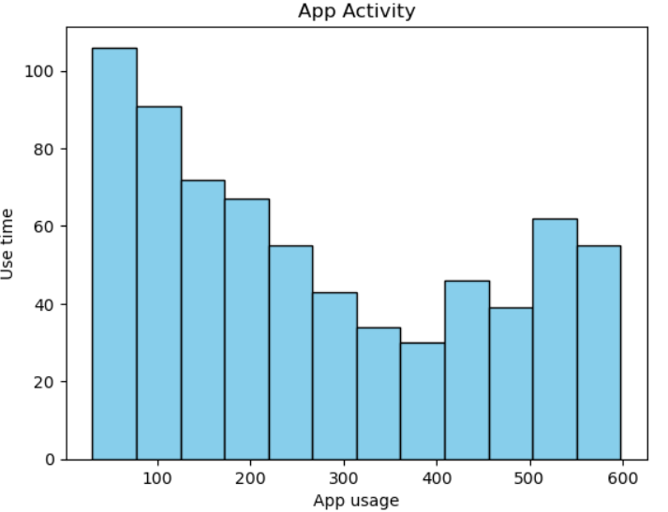
HISTOGRAM
Represents how the app usage time is elongated with respect to number of data points
X-axis represent time intervals (in minutes per day).
Y-axis indicating the frequency of days within each interval.
Function used to create : hist( )
Shows that the app usage times is a right-skewed distribution.
Reveals that most users tend to spend typical amount of time using apps each day.
Higher frequencies in certain usage time ranges and fewer days with extremely low or high usage.

Slide 8
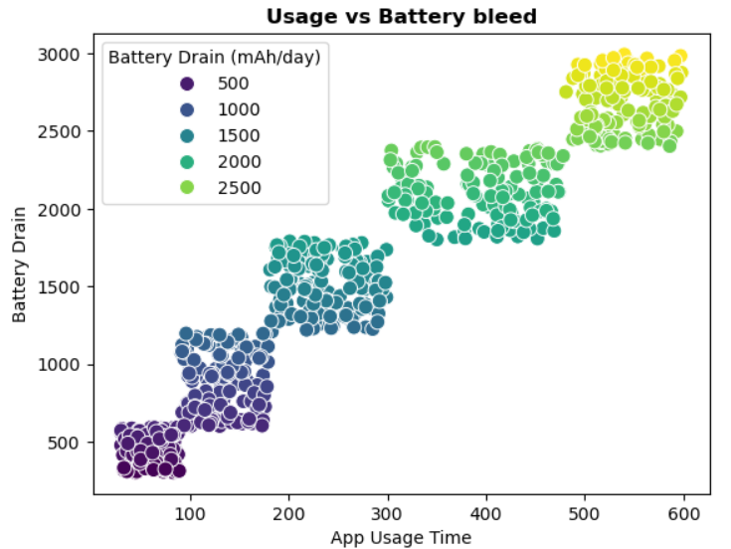
SCATTER PLOT
Represents the relationship between app usage time (in minutes per day) and battery drain (in mAh/day).
Shows colours of the points associated with Battery Drain
Yellow points highlights highest battery drain value
Suggests that users who use apps more tend to have higher battery drain.
Positive Correlation as points rise from left to right
Forming Clusters which shows distinct user behaviour.

Slide 9
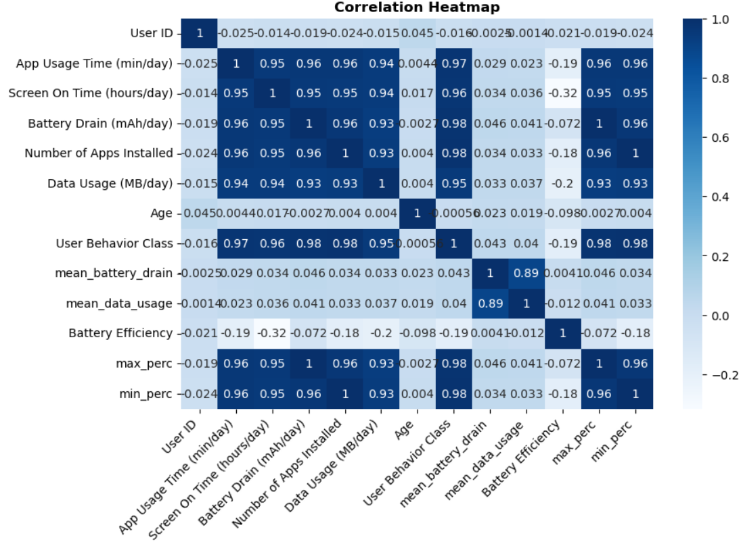
CORRELATION HEATMAP
Positive Correlation (Darker blue)
Calculates Pearson Correlation Coefficient between pairs of numerical values.
Shows correlation between each pair of numerical variables.
Zero or No Correlation
Negative Correlation (Lighter Blue)

Slide 10
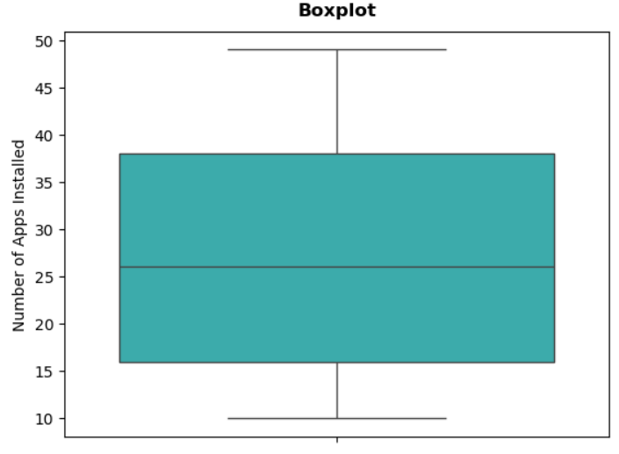
BOX PLOT
Provides visual summary of number of apps installed, highlighting the median, quartiles and outliers.
The whiskers extend from the box to min and max values within 1.5 times the interquartile range(IQR).
Benefits in finding outliers that fall outside the whiskers and are as individual points or dots outside whiskers.
The median (50th percentile) gives robust measure of central value, which is less affected by outliers compared to the mean

Slide 11
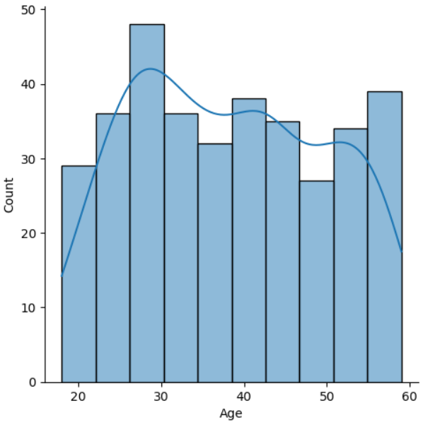
DISTRIBUTION PLOT WITH KDE
Generates a plot that shows the distribution of ages in the dataset.
Shows a smoothed, continuous curve that estimates the probability density function of the age distribution
This histogram will display frequency of different age ranges.
KDE curve will overlay a smooth line that estimates the density of the age distribution.
shows a smoothed, continuous curve that estimates the probability density function of the age distribution
We can conclude that the dataset is bimodal distribution with peaks in the late 20s early 30s and late 50s, indicating two main age groups with higher concentrations of users.

Slide 12
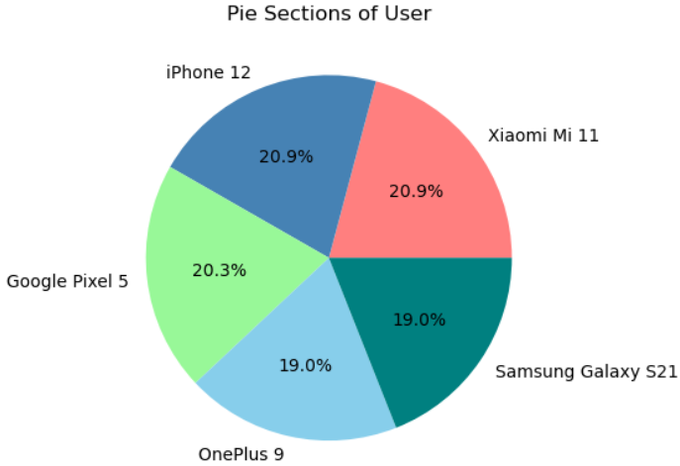
PIE CHART
Represents the distribution of users across five mobile device models.
Xiaomi Mi and iPhone 12 each hold the largest share at 20.9%.
Reveals relatively an even distribution among the devices with :
The labels on the pie chart indicate the different device models.
The size of each slice corresponds to the number of users for that device model.
OnePlus 9 and Samsung Galaxy S21 at 19.0%

Slide 13
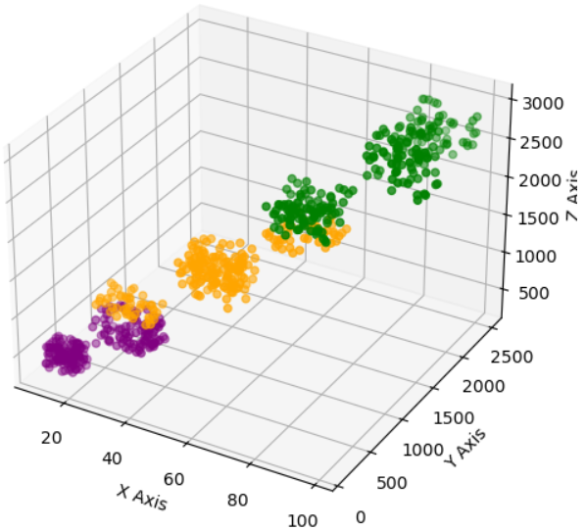
3D SCATEER PLOT
Reveals a clear upward trend, showing that users with more installed apps tend to have higher data usage and greater battery drain
Purple : represents low battery drain (<1000 mAh/day)
Green : represents high battery drain(>2000 mAh/day)
Orange : represents moderate battery drain (1000 - 2000 mAh/day)

Slide 14
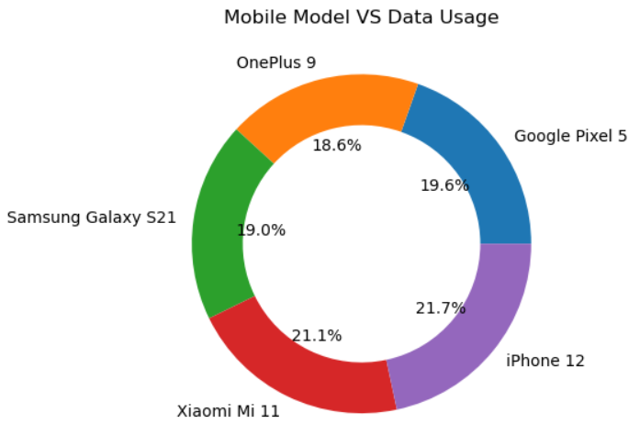
DONUT CHART
Summarizes how data usage (MB/day) is distributed across various device models.
Visualizes the average data usage across five mobile device models.
Each segment size proportional to the average data usage of users of that device.
Each slice will be labeled with the name of the corresponding device model.
Percentages indicate the proportion of total data usage designated to each device model.

Slide 15
CONCLUSION
This dataset provides valuable insights into how people interact with their devices.
We can analyze user habits, such as app usage patterns and browsing behavior.
The data also reveals details about device efficiency, including battery life and processing speed.
By analyzing this data, we can:
Enhance mobile technology to better meet user needs.
Improve user experiences by optimizing device performance and creating more intuitive interfaces.

